Slide 1



cyclomatric complexity
software metric

Slide 2
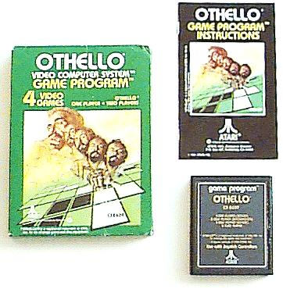
Agent program is the one part(class)of Othello program. How many test cases do you have to test?
Reversi [Othello]

Slide 3

Think again. This is program Reversi Brute force that have lines of code around 800 line. How complex is it. How many test cases at least do you want.
Reversi [Othello]

Slide 4

Cyclomatic complexity defines, how much complex does our computer program is. Means, it defines the overall degree of hardness in working of our program by using control flow graph
(we will talk with this topic later). One testing strategy called Basis path Testing ( by McCabe ) first proposed is
to test each linearly independent path through the program; in this case, the number of test cases will equal the cyclomatic complexity of the program.
How it is important?

Slide 5

White-box testing (also known as clear box testing, glass box testing, transparent box testing, and structural testing) is a method of testing software that tests internal structures or workings of an application, as opposed to its functionality (i.e. black-box testing). In white-box testing an internal perspective of the system, as well as programming skills, are required and used to design test cases. The tester chooses inputs to exercise paths through the code and determine the appropriate outputs. This is analogous to testing nodes in a circuit,
White Box Testing

Slide 6

CyVis is a free software metrics collection, analysis and visualisation tool for java based software.
CyVis collects data from java class or jar files. Once the raw data is collected, certain metrics like number of lines, statements, methods, classes and packages are obtained. Other metrics like cyclomatic complexity etc. are also being deducted.
What is CyVis?

Slide 7

A sequence of digits is obtained by writing down decimal representations
of all integers starting with 1 and continuing up to a certain number N
consecutively like this 12345678910111213141516171819202122 ... etc.
Task
Write a program that will compute the number of digits in such a sequence.
Input
The first and only line of input contains an integer N, 1 ≤ N ≤ 100,000,000.
Output
The first and only line of output should contain the number of digits in a sequence determined by the number given in the input.
Complex / No Complex

Slide 8
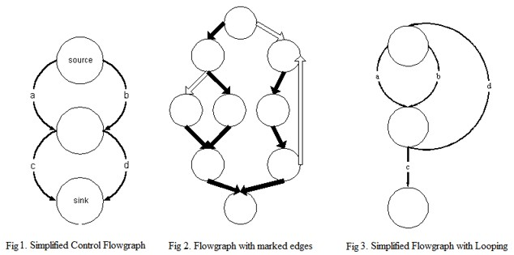
Control flow graph

Slide 9
Sum = sum = 10;
If (sum > 100)
done = 1;
Else
done = 0;
Endif
sum = sum +10;
sum > 100;
done = 1;
done = 0;
End if
How to do it by hands.

Slide 10
While (c)
while (c) {
x = y + 1;
y = 2 * z;
If(d) x = y + z;
z = 1;
}
z = x;
x = y + 1;
Y = 2 * Z
If(d)
x = y +z
z = 1
z = x
Example

Slide 11

Cyclomatic complexity is a software metric. It was developed by Thomas J. McCabe, Sr. in 1976 and is used to indicate the complexity of a program. It directly measures the number of linearly independent paths through a program's source code. The concept, although not the method, is somewhat similar to that of general text complexity measured by the Flesch-Kincaid Readability Test.
Definition of Complexity

Slide 12
Cyclomatic complexity is computed using the control flow graph of the program: the nodes of the graph correspond to indivisible groups of commands of a program, and a directed edge connects two nodes if that second command might be executed immediately after the first command.
Cyclomatic ecomplexity may also be applied to individual functions, modules, methods or classes within a program.
Definition of Complexity

Slide 13

The cyclomatic complexity of a section of source code is the count of the number of linearly independent paths through the source code. For instance, if the source code contained no decision points such as IF statements or FOR loops, the complexity would be 1, since there is only a single path through the code. If the code had a single IF statement containing a single condition there would be two paths through the code, one path where the IF statement is evaluated as TRUE and one path where the IF statement is evaluated as FALSE.
Definition of Complexity

Slide 14

Cyclomatic complexity is defined for each module to be E - N + 2, where
E and N are the number of edges and nodes in the control flow graph, respectively.
Cyclomatic complexity is also known as v(G), where v refers to the cyclomatic number in graph theory and
G indicates that the complexity is a function of the graph.
Definition of
Complexity number

Slide 15
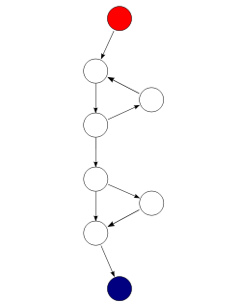
Mathematically, the cyclomatic complexity of a structured program is defined with reference to the control flow graph of the program, a directed graph containing the basic blocks of the program, with an edge between two basic blocks if control may pass from the first to the second. The complexity M is then defined as :
Where
E = the number of edges of the graph
N = the number of nodes of the graph
P = the number of connected components
M = E − N + 2P
Control flow graph
Notes:
Basic block is a portion of the code within a program with certain desirable properties that make it highly amenable to analysis. Compilers usually decompose programs into their basic blocks as a first step in the analysis process. Basic blocks form the vertices or nodes in a control flow graph.

Slide 16
A control flow graph of a simple program. The program begins executing at the red node, then enters a loop (group of three nodes immediately below the red node). On exiting the loop, there is a conditional statement (group below the loop), and finally the program exits at the blue node. For this graph
E = 9, N = 8 and P = 1
so the complexity of the program is 9 - 8 + (2*1) = 3
M = E − N + 2P
Control flow graph

Slide 17

An alternative formulation is to use a graph in which each exit point is connected back to the entry point
M = E − N + P
The function shown as a strongly connected control flow graph, calculation via alternative method. For this graph
E = 10, N = 8 and P = 1
so the cyclomatic complexity of the program is 10 - 8 + 1 = 3
Control flow graph
Notes:
In this case, the graph is said to be strongly connected, and the cyclomatic complexity of the program is equal to the cyclomatic number of its graph

Slide 18
Basic block is a portion of the code within a program with certain desirable properties that make it highly amenable to analysis. Compilers usually decompose programs into their basic blocks as a first step in the analysis process. Basic blocks form the vertices or nodes in a control flow graph.
The code in a basic block has:
one entry point, meaning no code within it is the destination of a jump instruction anywhere in the program one exit point, meaning only the last instruction can cause the program to begin executing code in a different basic block.
Control flow graph

Slide 19


Question
Cyclometric complexity is tool to measure density of the program. TRUE or FALSE?
Answer
Cyclometric complexity is tools to measure how the program complex. (not density)
quiz

Slide 20

Which one is the formula of complexity number?
A.)
M = N + E - P
B.)
P = E − N + M
Comment Uwe: Attention:
Please consider.
Formula following ISTQB:
M = L – N + 2P, where
– L = number of edges/links in a graph
– N = number of nodes in a graph
– P = number of disconnected parts of the graph (e.g. a called graph or subroutine).
Only in the strongly connected graph the formula is M = L – N + P.
C.)
M = E + N + 2P
D.)
M = E − N + P
quiz

Slide 21
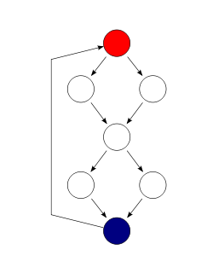
Transform this code to control flow graph.
    if( c1() )
    f1();
    else
    f2();
    if( c2() )
    f3();
    else
    f4();
quiz

Slide 22
In this graph calculate M by using formula of Control flow.
M = E − N + P
M = 8 – 7 + 1
M = 2
Comment Uwe: Attention:
There are 9 edges / links in the strongly connected graph – that’s why:
M = 9 – 7 + 1
= 2
quiz

Slide 23
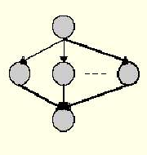
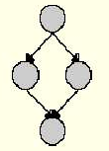
Which one have more complexity number ?
M = E − N + 2P
M = E − N + 2P
M = 4 − 4 + 2
M = 5 – 5 + 2
M = 2
M =2
Comment Uwe: Attention:
There are 6 edges / links in the right graph – that’s why:
M = 6 – 5 + 2
= 3
quiz

Slide 24

Show the complex program.(Agent and Reversi programs. How many test cases that they have to test?
How Cyclometric Complexity is important.
What is Complex number program. (CyVis)
How to do it by hands. (Control flow graph)
Definition.
Summary

Slide 25
In software testing life we cannot read by your eyes to determine how many test cases that you want. That’s make you less efficient. You can use Cyclometric complexity to measure how program complex is. By using program CyVis or another program to measure complexity. In real life you cant trust all of complexity number 99% you can trust and 1% you cannot trust it.
In switch cases it’s count 1 case to 1
Summary

Slide 26
const String weekDayName(const int number) {
  switch(number)
  {
  case 1: return "Monday";
  case 2: return " Tuesday";
  case 3: return "Wednesday";
  case 4: return "Thursday";
  case 5: return "Friday";
  case 6: return "Saturday";
  case 7: return "Sunday";
  }
return "unknown weekday";
}
Switch case Ex

