Slide 1
Test Automation
Atit Leelasuksan 5510546221
Rungroj Maipradit 5510546654

Slide 2
Concept
control the execution of tests
comparison of actual outcomes with predicted outcomes

Slide 3
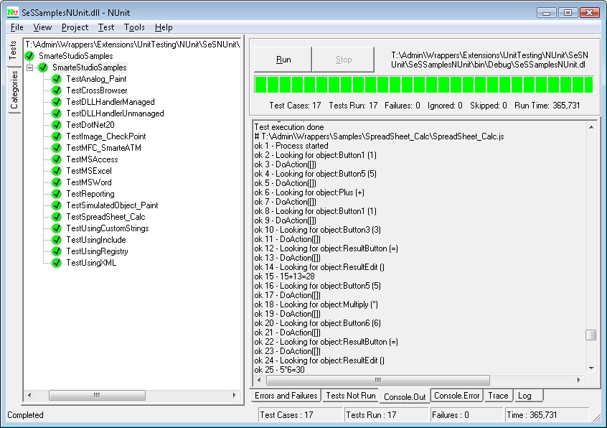
Example Tool - NUnit
https://www.inflectra.com/Rapise/Highlights/Unit-Testing.aspx

Slide 4
Why
Continuous delivery and continuous testing
Regression testing
Reduce man-power in testing

Slide 5
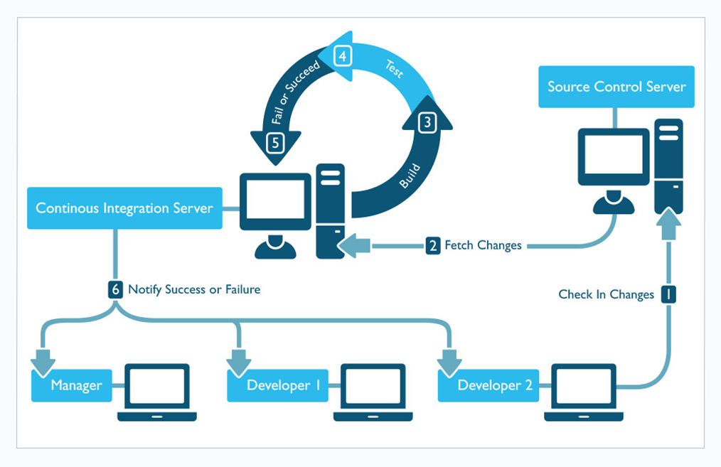
In practice
http://www.pepgotesting.com/continuous-integration/

Slide 6
Example Tool
Web automate
Selenium (Open Source)
GUI automate
Ranorex (Commercial)
Unit Testing
JUnit (Open Source)

Slide 7
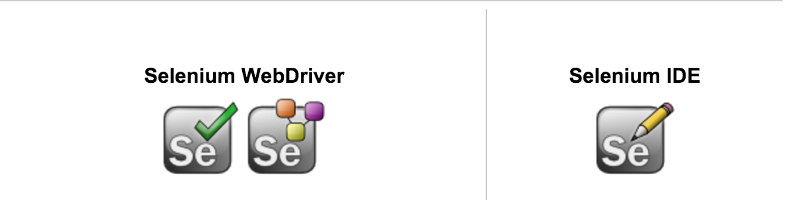
Selenium
Selenium is a tool to automates browsers.
It is for automating web applications for testing purposes.
Web-based administration tasks can (and should!) also be automated as well.

Slide 8
Selenium
Selenium has 2 part
Selenium Webdriver
Selenium IDE

Slide 9
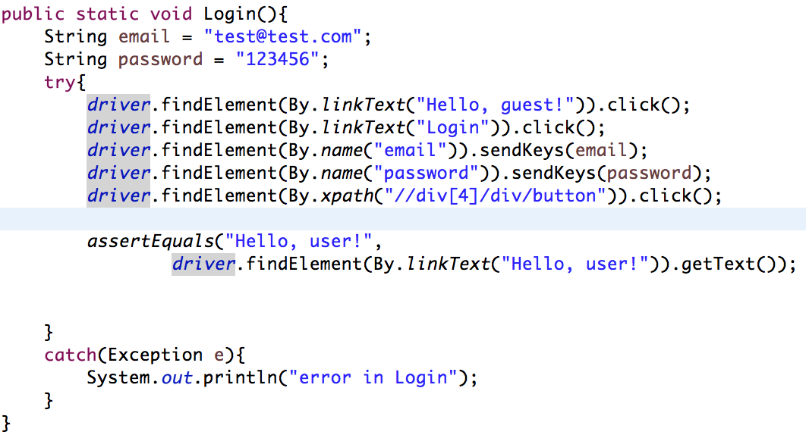
Selenium Webdriver
Selenium support a lot of computer languages
Java
C#
Ruby
Python
Javascript ( Node JS )

Slide 10
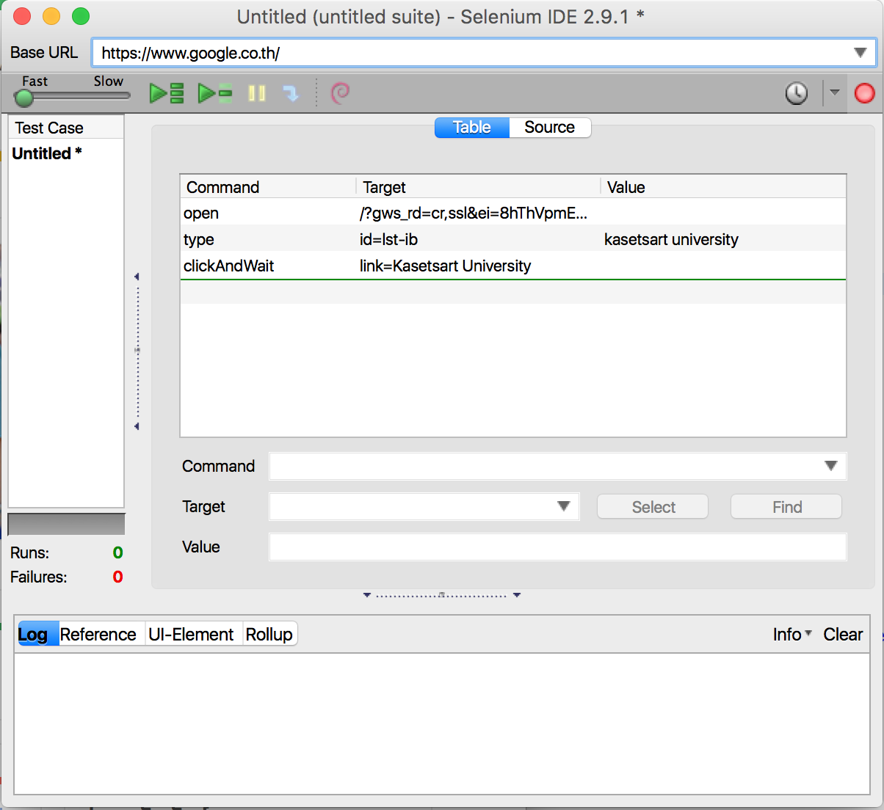
Selenium IDE
Selenium IDE has built in Firefox.
- Doesn’t require any programming knowledge.
- Use capture and replay method.

Slide 11

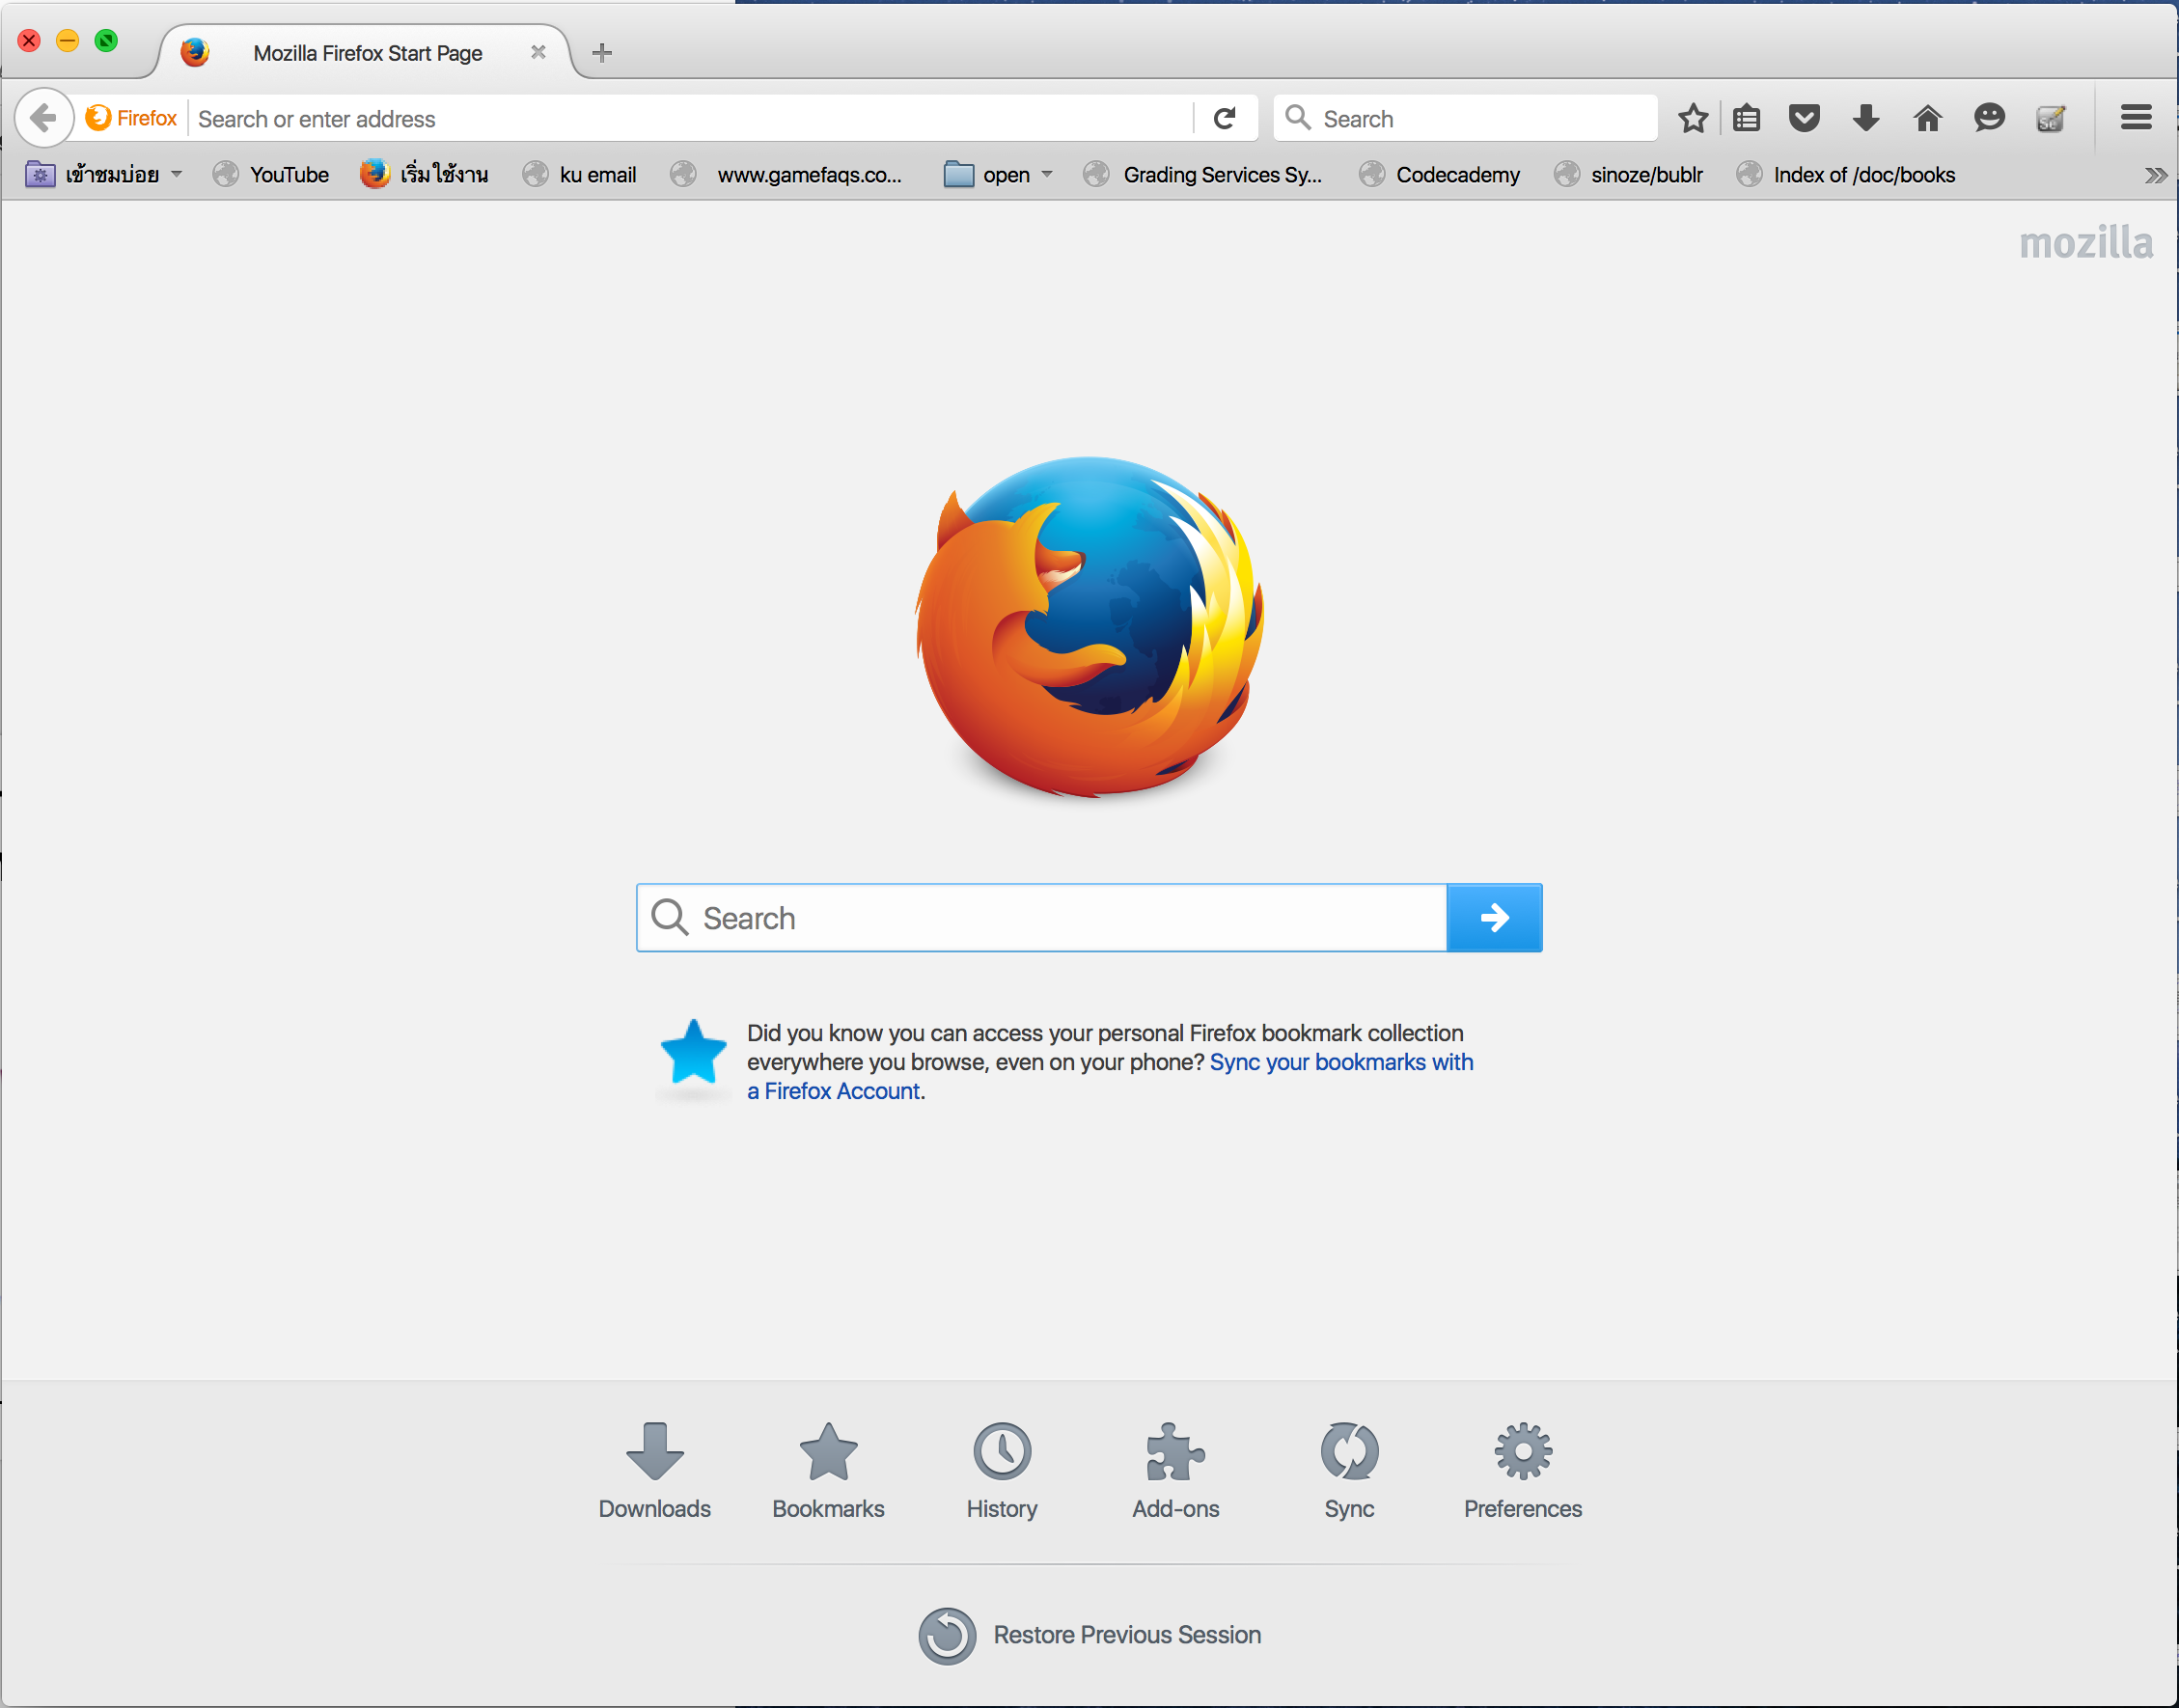
Selenium Java syntax
Create Driver
Result

Slide 12

Selenium Java syntax
Open Website
Result

Slide 13
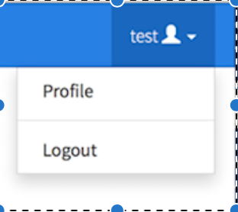
Selenium Java syntax
Open Link
Result

Slide 14
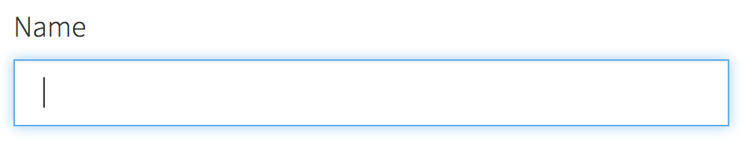
Selenium Java syntax
Open Link
Result

Slide 15
Demo

Slide 16
Exercise

Slide 17
Exercise 1
Open https://mike.cpe.ku.ac.th/~uwe/01219343/index.html
Try to open latest quiz.
Then try to do it again with automate.

Slide 18
Exercise 2
Open google.
Search kasetsart university.
Open kasetsart website.
Then try to do it again with automate.

Slide 19
Why exercise 2 fail
Problem
Can’t find element link = Kasetsart University
Why
Selenium can’t find inconsistent data such as google search
Selenium capture and replay has a problem with wait.

Slide 20
Exercise 3
In your pair, one act as test manager one act as tester.
Test manager choose one website of your choice (your project is ok) and one requirement to test
Tester try to test selected website with given requirement
Discuss the result

Slide 21
Discussion

Slide 22
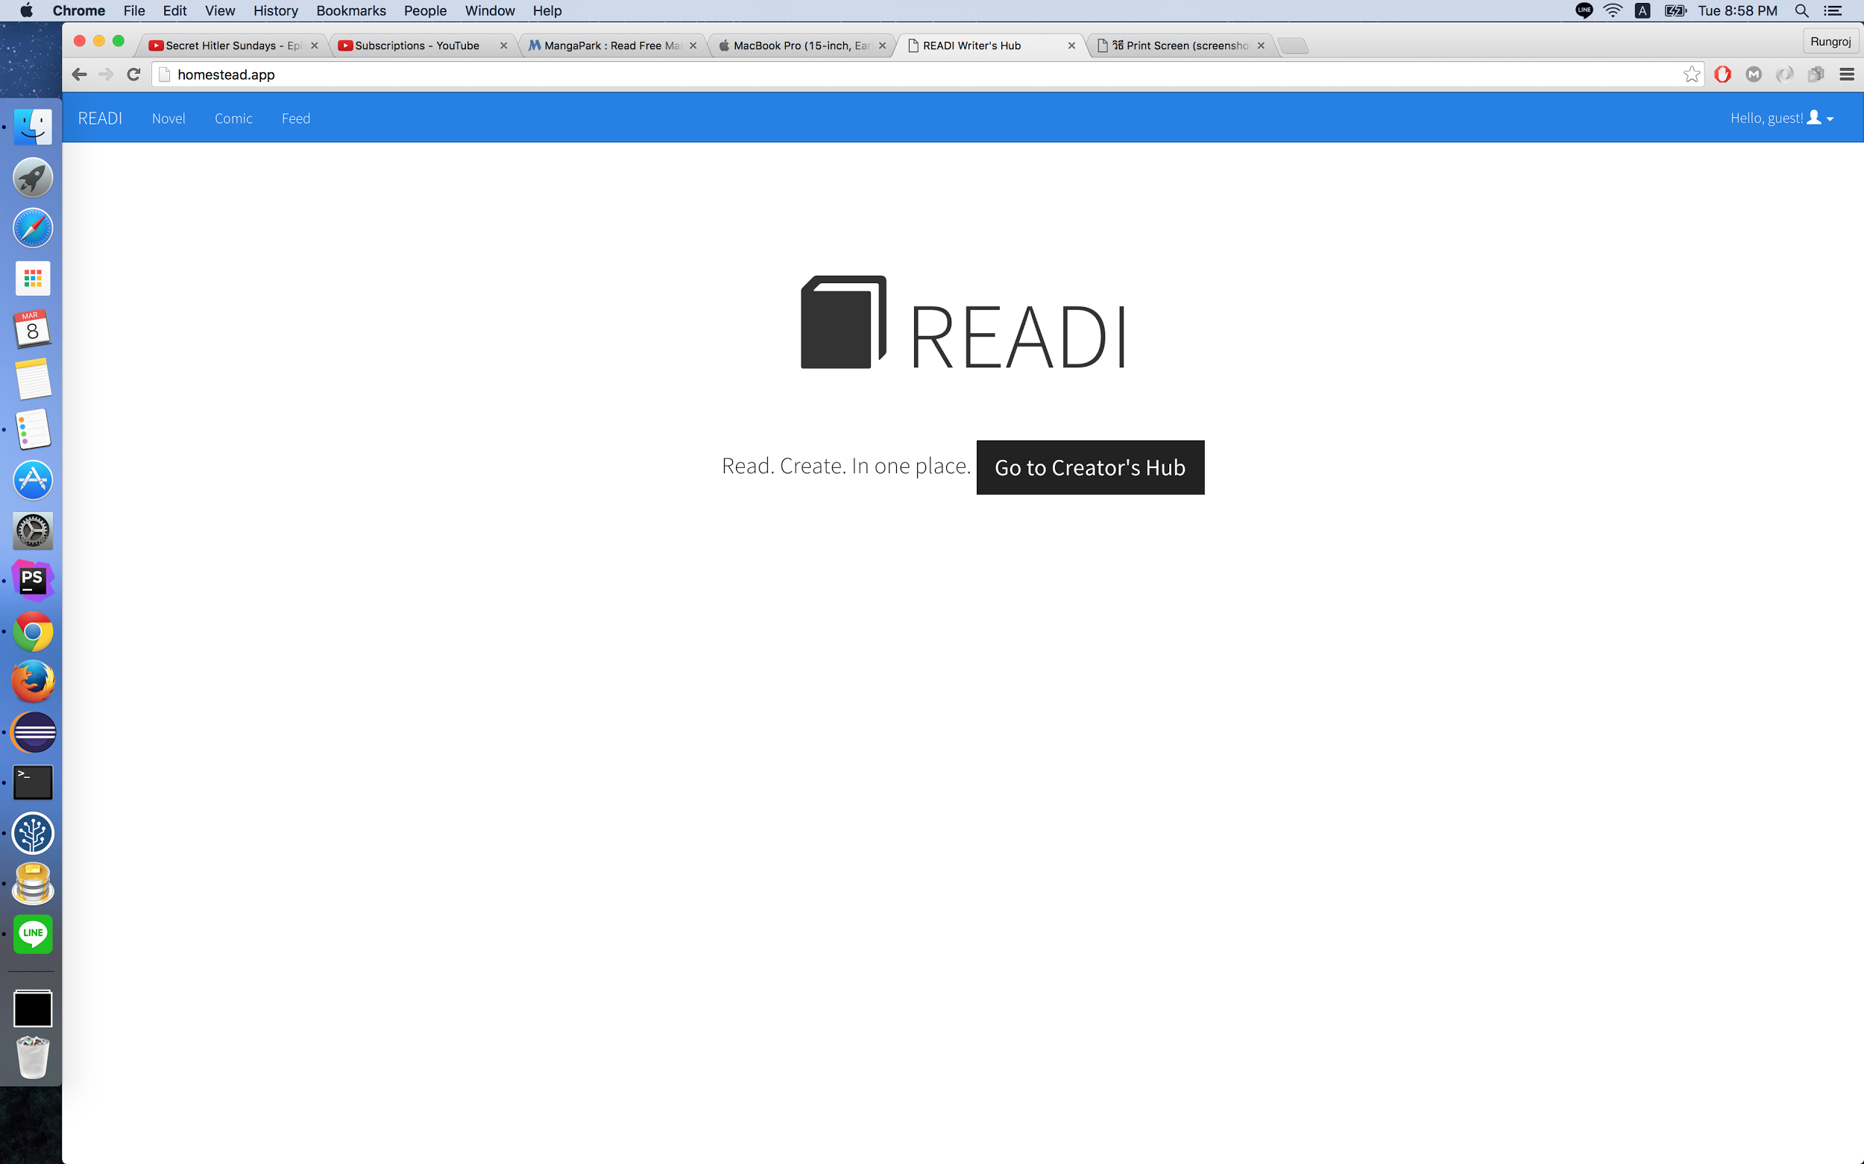
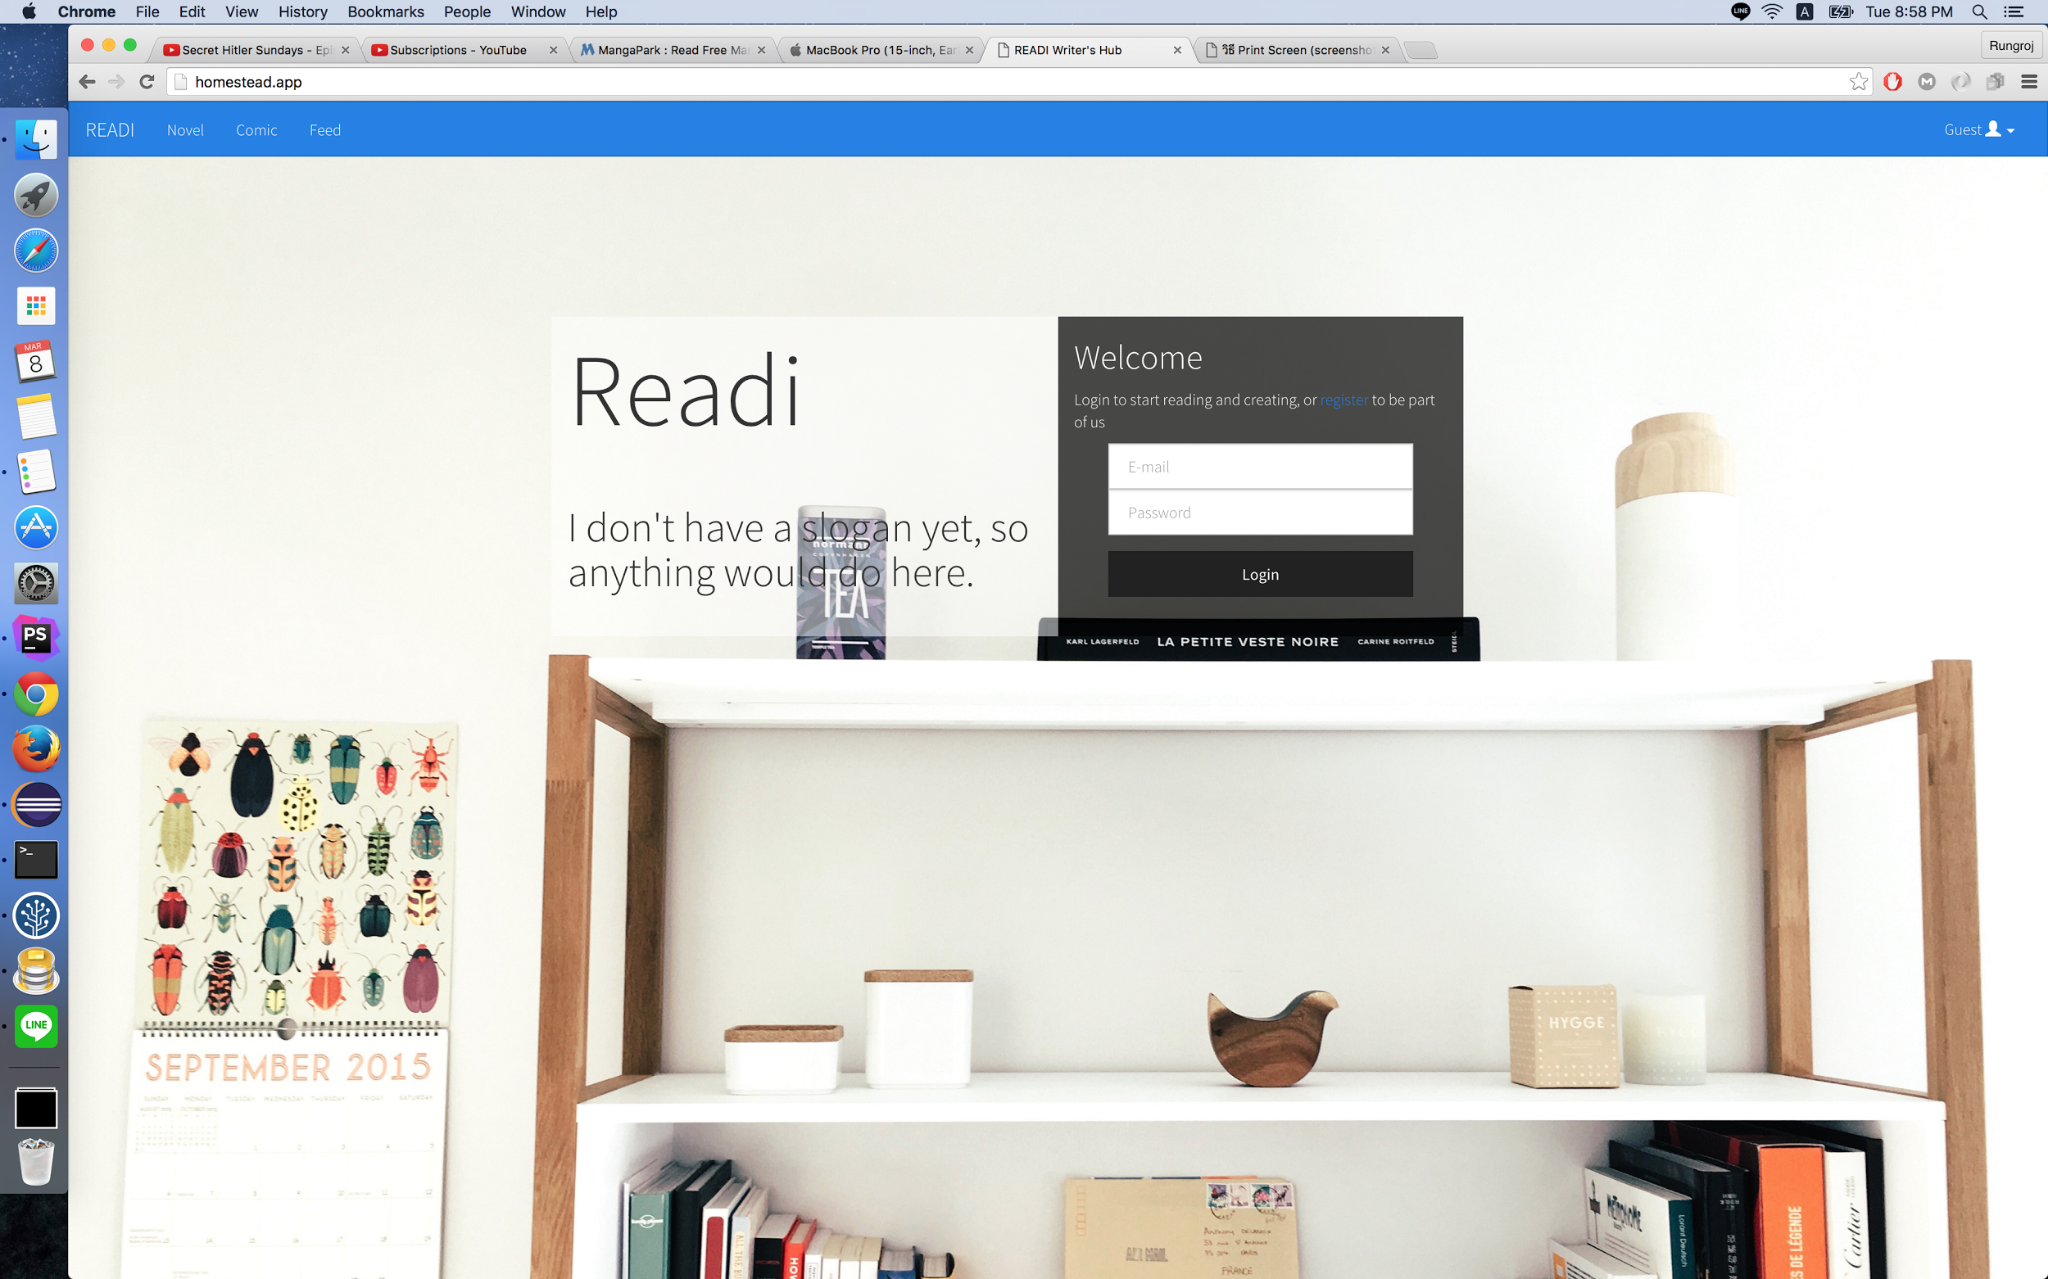
Problem in Our project / How to solve
Problem occur when web change UI.
Fix workflow.
Set ID for each button and textfield.
Use routes instead of clicking if possible.
Run in unit test to see which function doesn’t work.

Slide 23
Pros
Cons
Repeatability
Took time longer than manual testing

