Slide 1
You’ll get better code in less time
(If you do it for a while)

Slide 2
Workshop
Download
Start guessing range can be setted.
Game have only one answer.
User can guess a number in between guessing range
After a guess game will tell how far is the answer
  If guess correct will result ‘HIT’
  greater or lesser between 1 - 5 will get ‘Very close’
  greater or lesser between 6 - 20 will get ‘Close’
  greater or lesser between 21 - 40 will get ‘Not close’
  greater or lesser 41 will get ‘Forget it’
User have limited change to guess

Slide 3
Test Driven Development & Unit Test
By: Krittayot Techasombooranakit &
Supavit Kongwudhikunakorn

Slide 4
Unit Testing
Sources:-
Computer Science and Engineering, University of Washington
Electrical Engineering and Computer Science, Massachusetts Institute of Technology
The Art of Unit Testing
Martin Fowler

Slide 5
Definition
A software development process in which the smallest testable parts of an application, called units, are individually and independently scrutinized for proper operation.
(src: http://searchsoftwarequality.techtarget.com/definition/unit-testing)

Slide 6
Concept
For a given class Rorpap, create another class RorpapTest to test it.
RorpapTest contains various “test case” methods to run
Each method looks for particular results and passes / fails

Slide 7
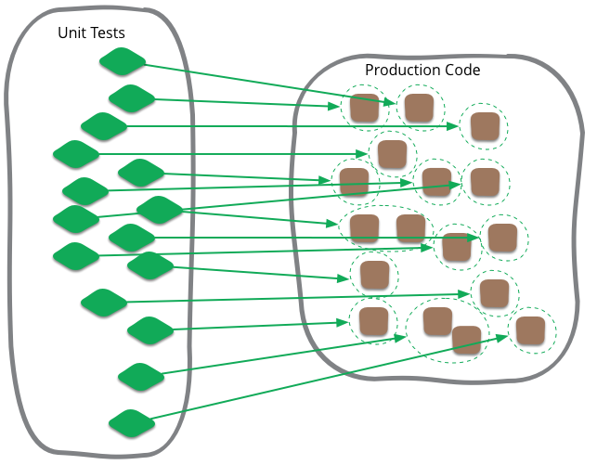
(src: http://martinfowler.com/bliki/images/unitTest/sketch.png)

Slide 8
Properties of a good unit test
should be automated and repeatable
should be easy to implement
once it’s written, it should remain for future use
anyone should be able to run it
should run at the push of a button
should run quickly

Slide 9
Tips for writing unit test
You cannot test every possible input, parameter value, etc.
  so you must think of a limited set of tests likely to expose bugs
Think about boundary and empty cases
  positive; zero; negative numbers
  min/max value
  right at the edge of an array or collection’s size
  null; an empty array or list; empty string
  bugs often occur at boundaries
    off-by-one error
    forget to handle empty container
    arithmetic overflow
Test behavior in combination
  maybe add usually works, but fails after you call remove
  make multiple calls; maybe size fails the second time only

Slide 10
Trustworthy unit tests
Test one thing at a time per test method
  10 small tests are better than 1 test 10x as large
Each test method should have few (likely 1) assert statements
  If you assert many things, the first that fails stops the test.
  You won’t know whether a later assertion would have failed
Tests should avoid logic.
  minimize if/else, loops, switch, etc.
  avoid try/catch
    If it’s supposed to throw, use expected

Slide 11

Test case “smells”
Tests should be self-contained and not care about
each other.
“Smells” (bad things to avoid) in tests
  Constrained test order (i.e. Test A must run before Test B)
  (usually a misguided attempt to test order/flow)
  Tests call each other (i.e. Test A calls Test B’s method)
  (calling a shared helper is OK, though)
  Mutable shared state (i.e. Tests A/B both use a shared object).
  (if A breaks it, what happens to B?)

Slide 12
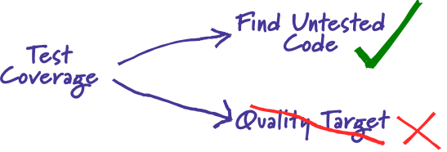
Test coverage

Slide 13
Test coverage
If you make a certain level of coverage a target, people will try to attain it.
  Trouble: High coverage numbers are too easy to reach with low quality testing
  Trouble: Distracting you from testing the things that really matter
Low coverage numbers are a sign of trouble
High coverage numbers don’t necessarily assure bugs free

Slide 14
How much testing is enough?
You rarely get bugs that escape into production
You are rarely hesitant to change some code for fear that it will cause production bugs

Slide 15
Unit test frameworks
Grunt, Mocha, Chai - Javascript
์๊์๊ืNUnit - .NET
JUnit - Java
minitest - Ruby
py.test - Python
SnapTest - PHP

Slide 16
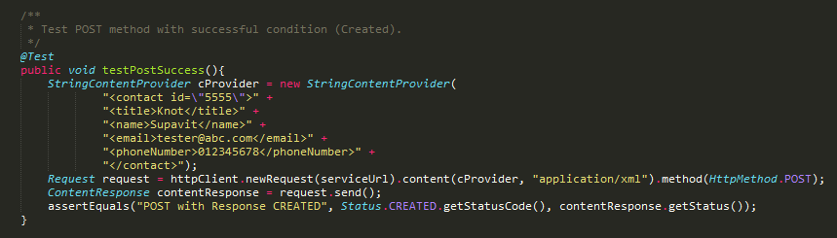
Example of Unit Test

Slide 17
Exercises

Slide 18
Exercise 1
Design a unit test to determine if the input number considered to be a prime number
Description: It accepts any input n for n is a number where 1 <= n <= 100
It outputs “prime number” if n is a prime number;
otherwise, “not a prime number”;
If n is invalid, “invalid”

Slide 19
Exercise 1 - Solution
If n is not a number, invalid
If n is -1, invalid
If n is 0, invalid
If n is 1, not a prime number
If n is 2, prime number
If n is 3, prime number
If n is 50, not a prime number
If n is 97, prime number
If n is 100, not a prime number
If n is 101, invalid

Slide 20
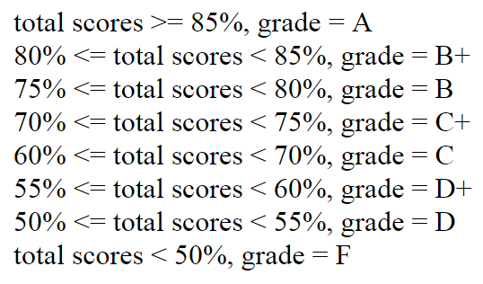
Exercise 2
Design a unit test to determine grade by inputting a total scores
Description: It accepts any input n for n is a number where 0 <= n <= 100
n is considered valid only when 0 <= n <= 100
n can contains decimal places
It outputs corresponding letter grade if n is valid;
otherwise, “invalid”

Slide 21
Exercise 2 - Solution
If n is not a number, invalid
If n is below 0, invalid
If n is more than 100, invalid
If n is 0, F
If n is 50, D
If n is 55, D+
If n is 60, C
If n is 70, C+
If n is 75, B
If n is 80, B+
If n is 85, A
If n is 100, A

Slide 22
Test-driven development

Slide 23
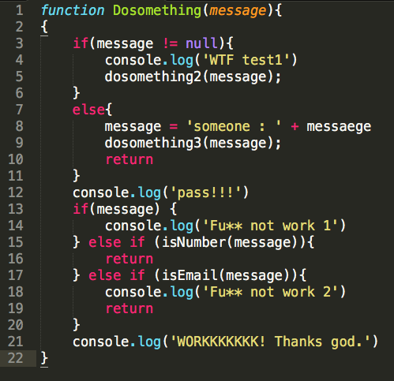

Slide 24
Test-driven development
Shortest development cycle in software process
Quality assure every cycle

Slide 25
TDD Cycle
Write test case
(Fail)
Refactor
(Cleaned)
Make some change
(Pass)

Slide 26
Step-by-step
Add test (Design in your head)
Run the test (Make sure it’s fail)
Write the code
Run the test (Make sure it’s pass)
Refactor

Slide 27
Behavior-driven development (BDD)
Ensure every behavior in the user stories have done
Describe in human way (not technician)
Good for principal or customer perspective
Given-When-Then statements

Slide 28
TDD
Write test case
(Fail)
Refactor
(Cleaned)
Make some change
(Pass)

Slide 29
BDD
TDD
Write behavior
test case
(Fail)
Fail
Cleaned
Pass

Slide 30
What you get.
Testable code
Design and plan before code
Documents the design in themselves
Actually know what to code
Cleaned code
Make code significant better

Slide 31
Keep in minds
“The 4 Rules of Simple Design”
  Pass all test
    If have any fail have to fix immediately
  DRY - No duplicated code
    Every piece of behavior must have only one representation
  Reveal intent
    Make naming easy to understand
    Meaningful naming
  Keep it small
    Never code what is not use
    Minimise number of code (no over structure)
Hard/External modules may not be worth to test
Avoid overtesting
Sometime you can’t avoid exploratory coding

Slide 32
Workshop - Guessing games
Game must have start and end range of guessing number.
Guessing range is between 0 to 100
Start guessing range can be setted
Answer randomed at the start of the game in between guessing range.
User can guess a number in between guessing range.
After a guess game will tell how far is the answer
  If correct will get ‘HIT’
  greater or lesser between 1 - 5 will get ‘Very close’
  greater or lesser between 6 - 20 will get ‘Close’
  greater or lesser between 21 - 40 will get ‘Not close’
  greater or lesser 41 will get ‘Forget it’
User have limited change to guess

Slide 33
Workshop
Downloads
  Node.JS
  Vistual Studio Code (Optional)
Clone template
  open commandline
  type in
    “git clone https://github.com/benzsuankularb/js-template.git”
    cd js-template
    npm install
Test setup
  open commandline
  type in
    mocha

Slide 34
Additional
Kind of TDD
  Mockist TDD (Outside-In)
  Classicist TDD (Inside-out)
Bad of TDD
  TDD make your code significant better, Also can make your code significant terrible.
  Cost much time if not a TDD expert

Slide 35
You’ll get better code in less time

